Slide 1
Hospital Operation Room – Utilization Analysis

Slide 2
Problem Statement
Operating room (OR) inefficiency is a significant financial burden on healthcare organizations, impacting both cost and patient care.
While booked OR time represents a planned utilization metric, it often deviates from the actual time procedures take due to workflow delays, inaccurate booking estimates, and cancellations.
This project aims to leverage a dataset containing surgical timestamps throughout the OR workflow to identify and quantify these areas of inefficiency.
By analyzing this data, we can develop actionable insights to optimize OR utilization, potentially saving healthcare organizations substantial time and financial resources, and ultimately improving patient care delivery

Slide 3
Expectation from this Report
Analyze OR workflow data to pinpoint delays and inaccuracies in booking estimates.
Provide actionable insights to improve scheduling and reduce cancellations.
Estimate potential cost savings and increase procedure throughput.
Propose strategies to streamline OR processes, reducing wait times and improving outcomes.
Apply data analytics techniques and improve proficiency in statistical tools.
Create clear visualizations and comprehensive reports to communicate recommendations.
By completing this project, healthcare organizations can expect to save time and resources while enhancing patient care delivery.

Slide 4
Description/Terminology of Features in Dataset
Encounter ID → Unique/Primary Key for the Record
Date --> The date of the surgery.
OR Suite --> The operating room where the surgery will take place.
Service --> The surgical specialty.
CPT Code --> The code for the surgical procedure.
CPT Description --> A description of the surgical procedure.
Booked Time (min) --> The amount of time that was booked for the surgery.
OR Schedule --> The time that the surgery was scheduled to start.
Wheels In --> The time that the patient arrived in the operating room.
Start Time --> The time that the surgery started.
End Time --> The time that the surgery ended.
Wheels Out --> The time that the patient left the operating room.

Slide 5
New Features Extracted
'Week#’ → Week Number of the Year
'Dayofweek’ → Day of the Week (Monday ~ Sunday)
BookingHr → Schedule Hr of the Day
'ORSchedule_Wheelsin’, → Duration from OR Schedule to Wheelsin
'Wheelsin_Start’ → Duration from Wheelsin to Start
'Start_End’ → Duration from Start to End
End_Wheelsout’ → Duration from End to Wheelsout
'Wheelsin_Wheelsout’ → Duration from Wheelsin to Wheelsout
'ORSchedule_Wheelsout’, → Duration from ORSchedule to Wheelsout
'ORSchedule_Wheelsin Ratio’ → OR Schedule to Wheelsin Ratio w.r.t Booked Time
'Wheelsin_Start Ratio’ → Wheelsin_Start Ratio w.r.t Booked Time
'Start_End Ratio’, → Start_End Ratio w.r.t Booked Time
'End_Wheelsout Ratio’ → End_Wheelsout Ratio w.r.t Booked Time
'ORSchedule_Wheelsout Ratio’ → 'ORSchedule_Wheelsout Ratio w.r.t Booked Time

Slide 6
Business KPI’s
Time Period : 3rd Jan ~ 31st Mar 2022
No of Services [Specialties] | No of CPT [Surgical Procedures] | Weekly Working Days | Avg No of Procedure/Week
No of OR Suite | OR Working Hours | OR Engaged Ratio/Day | OR Actual Usage Ratio/Day
10
32
5
167
8
7:00 ~ 17:00
[10 Hrs - 600 Minutes]
0.84
0.58
[349 Minutes]

Slide 7
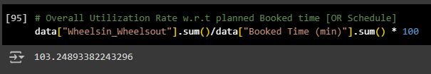
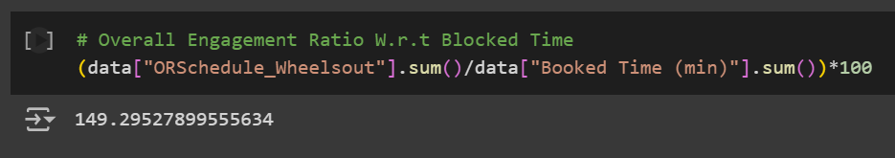
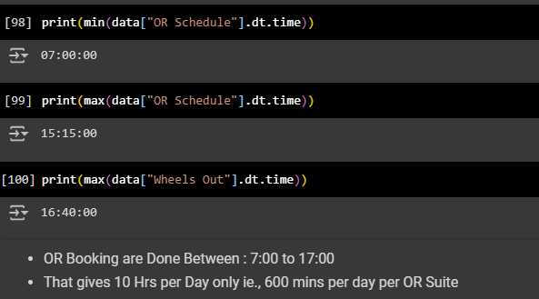
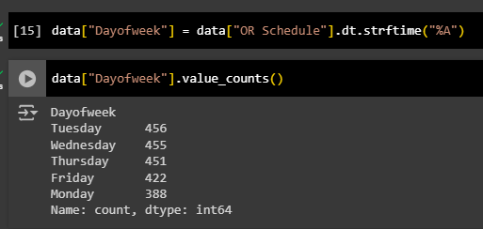
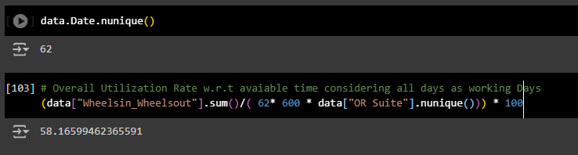
Utilization Rate
Actual Utilization Rate w.r.t Booked Time | 103%
OR Engagement Rate w.r.t Booked Time | 149%
Actual Utilization Rate w.r.t Available time in a Day [7:00 ~ 17:00] | 58%
OR Rooms are used only between 7:00 ~ 17:00 and only on Weekdays i.e., 5 Days
Actual Usage time is 3% More than the Booked time, But Overall Engaged time is 49% more than booked time
But Utilization rate w.r.t. to Total Available OR Suite Time is Low i.e, 58% only

Slide 8
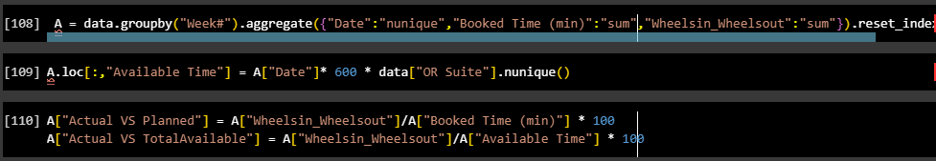
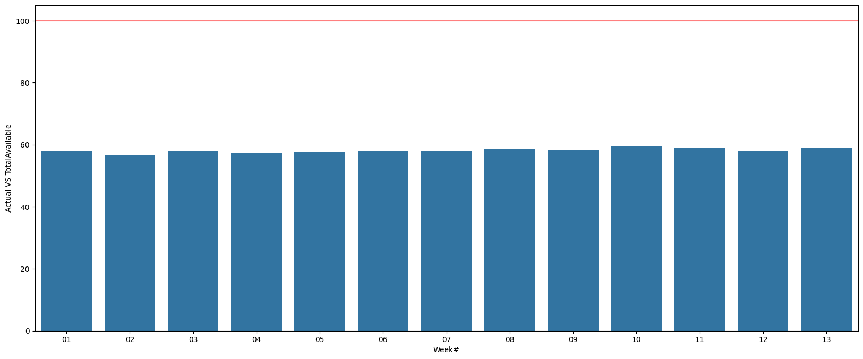
Week wise Utilization Rate
Overall Utilization rate w.r.t Available time in a Day [No of Working Days * 600 Mins] | 56.61~59.57%
100%
Maximum Possible Limit
Utilization rate was almost same for all week.. Varied around 56.61 ~ 59.57%

Slide 9
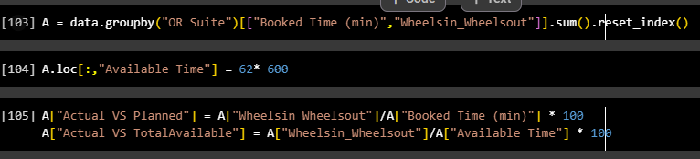
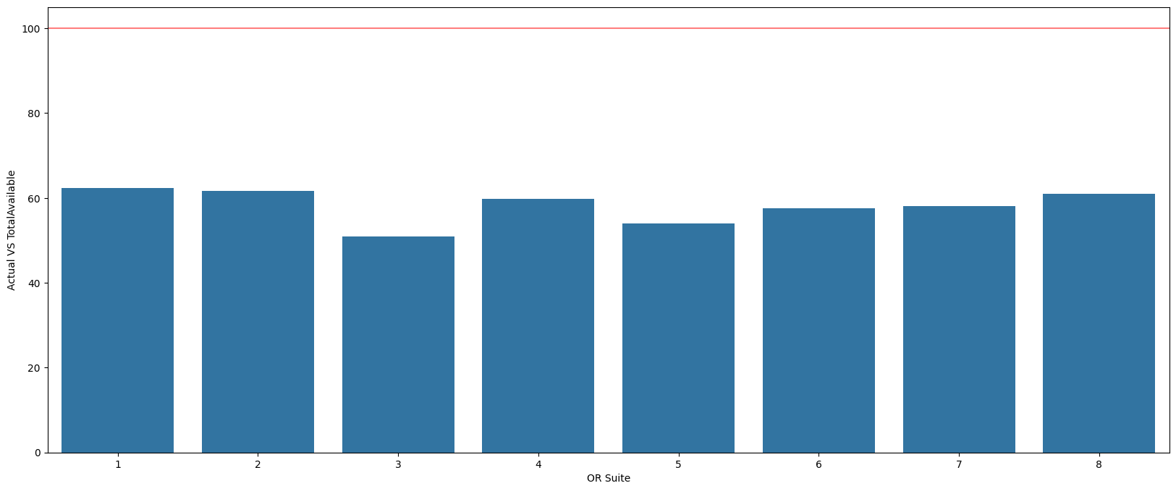
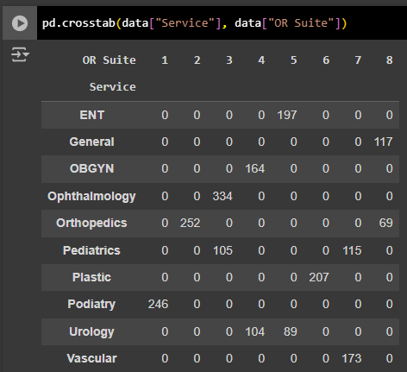
OR Suitewise Utilization Rate
Overall Utilization rate w.r.t Avaiable time | 50.83~62.37%
Utilization rate Varied w.r.t OR Suites.. Varied around 50.83 [OR:3]~62.37%[OR:1]
Even though High number of Procedure conducted by Ophthalmology, their overall usage rate is less compared to others [may be due to 30 Min Procedure time].. Resource Balancing can be done with external agencies as time frame followed are also accurate
OR1 has Highest Utilization rate which is used by Podiatry Service

Slide 10
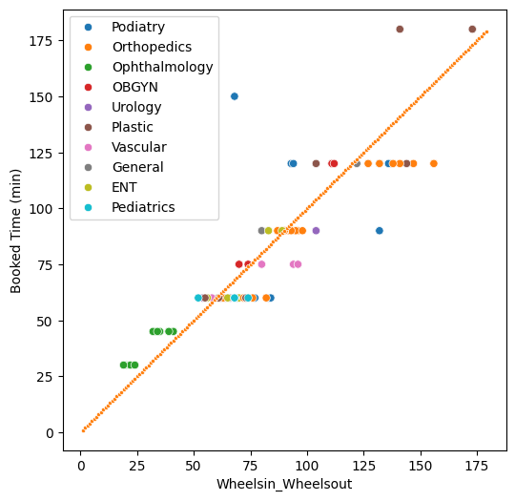
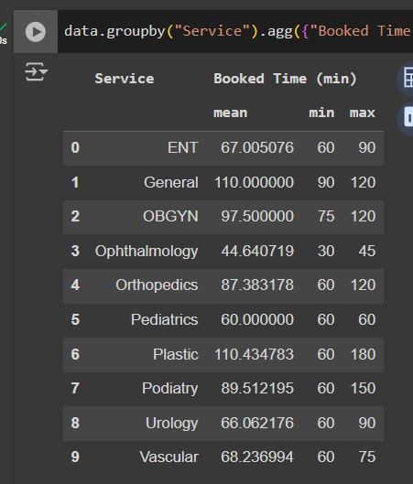
Planned Vs Actual Usage – Service Wise
OR Suite & Service Mapping
Planned : OR Schedule (min)
Actual Usage : Wheelsin_Wheelout
Ophthalmology & OBGYN Completed Procedure before the Booked time Slot
[Their booking Time slot are accurate]
How ever Rest all Services Vary actual time w.r.t Booking time → Need to analyze the Actual Time Requirement as per the CPT Procedure

Slide 11
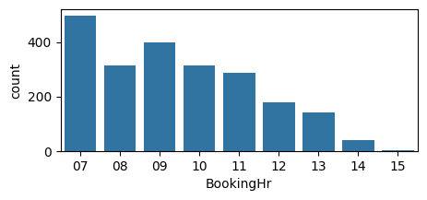
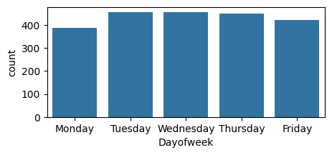
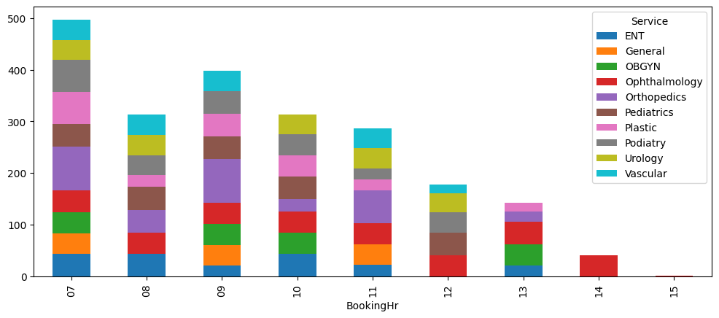
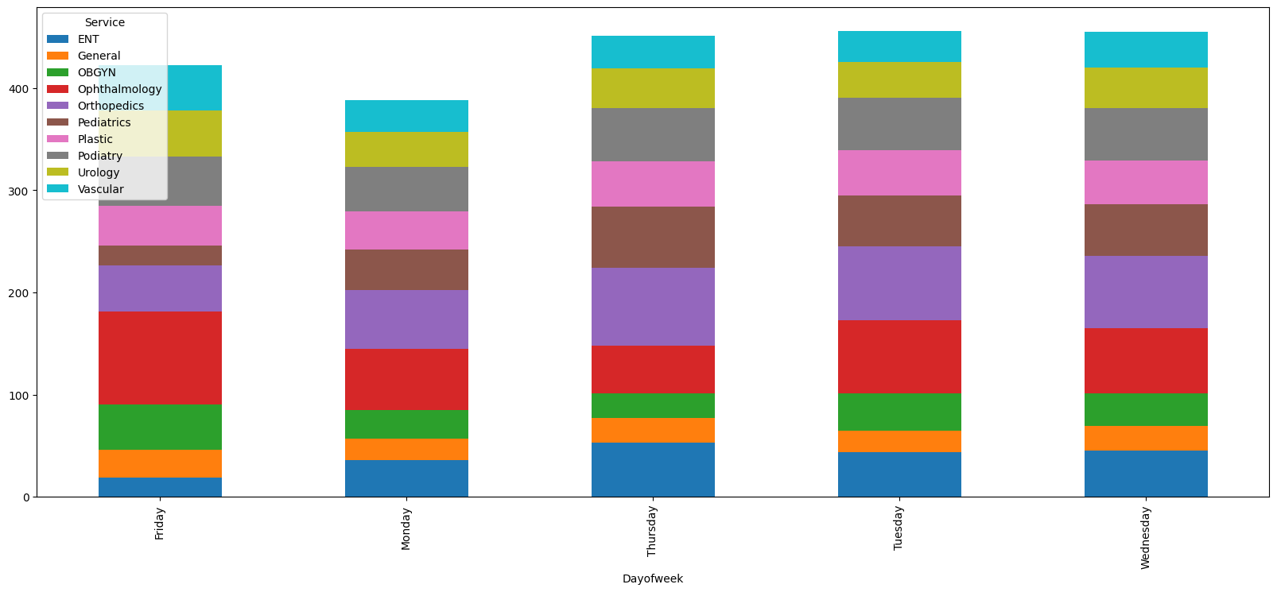
WeekDay And BookingHr Analysis
OR Suites Booking is High in the Morning Session & Bookings Decreases as the Day Progresses
Also Booking rate is comparatively high in the Middle of Week and Low on Monday & Friday
Only Ophthalmology Service conducts Procedure in Afternoon Session also, rest all plans only in Morning Session

Slide 12
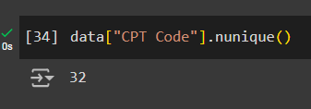
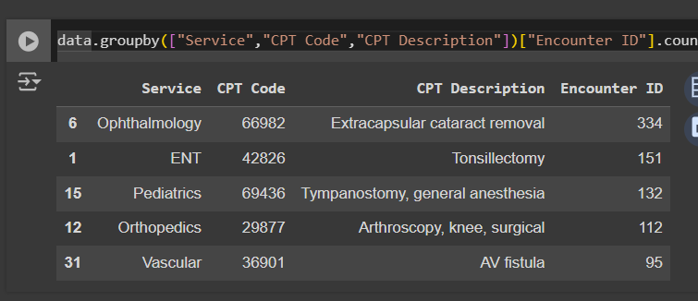
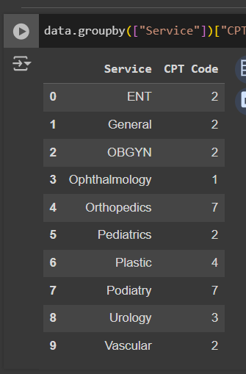
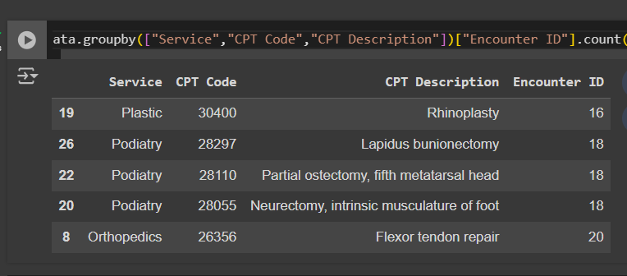
Service – CPT Procedure Analysis
Total CPT Procedures:
Top 5 CPT Procedure in Qty:
Service – CPT Procedure Mapping
Bottom 5 CPT Procedure in Qty:

Slide 13
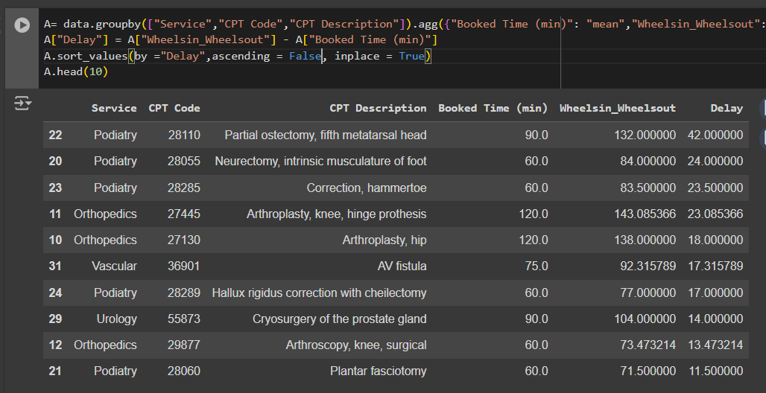
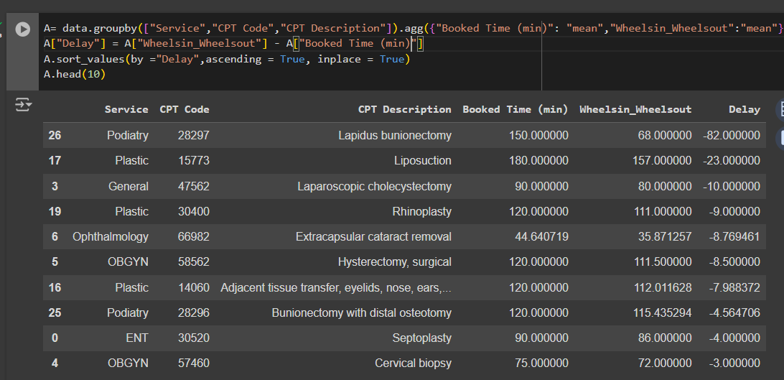
Planned Vs Actual Usage – CPT Procedure Wise
Top 10 Overusing Procedures
Top 10 Underusing Procedures
Scope to Plan The OR Schedule Booking Time Accurately to eliminated Safety Precautions of Time Duration taken by Other Procedure While Booking
Scope to Reduce Over booking to Make OR Suite Available for Booking
Duration Booking time for for a Procedure is Almost Same for all CPT Procedure Except for “Extracapsular Cataract removal”
Very High Over booking done for “Podiatry Service - Lapidus Bunionectomy “ with Excess time of 82 Mins
Further Over usage of 42 Mins is Observed in “Podiatry – Pastial Ostectomy, fifth metatarsal head”
Podiatry and Orthopedics Services Booking time must be correctly Recalibrated as per the Actual CPT Procedure to increase Usage Efficacy

Slide 14
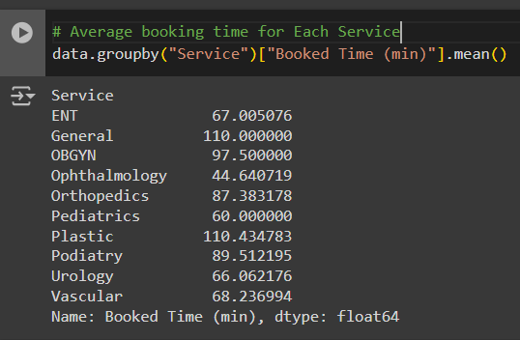
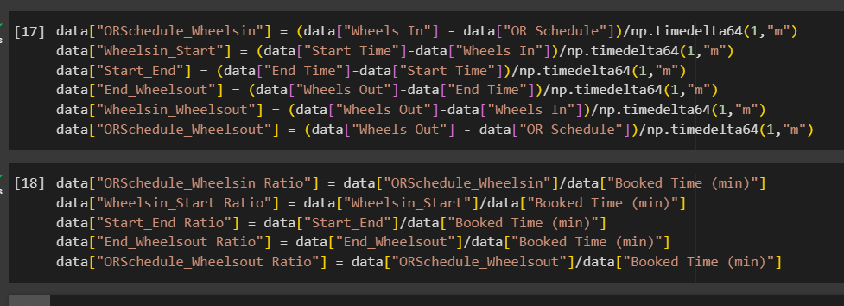
Analysis of time between key stages (OR Schedule -Wheels In, Wheels In - Start Time, Start Time - End Time, End Time - Wheels Out)
Service wise Average Booking Time
Each Service has Different Procedure time
So, We cannot Directly Compare the Time of Key Stage
So, we will take Parameter in the Form of Ratio W.r.t Booked Time as Below for Uniform Analysis across all Categories

Slide 15
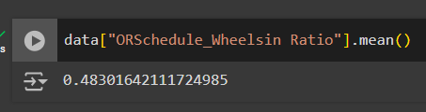
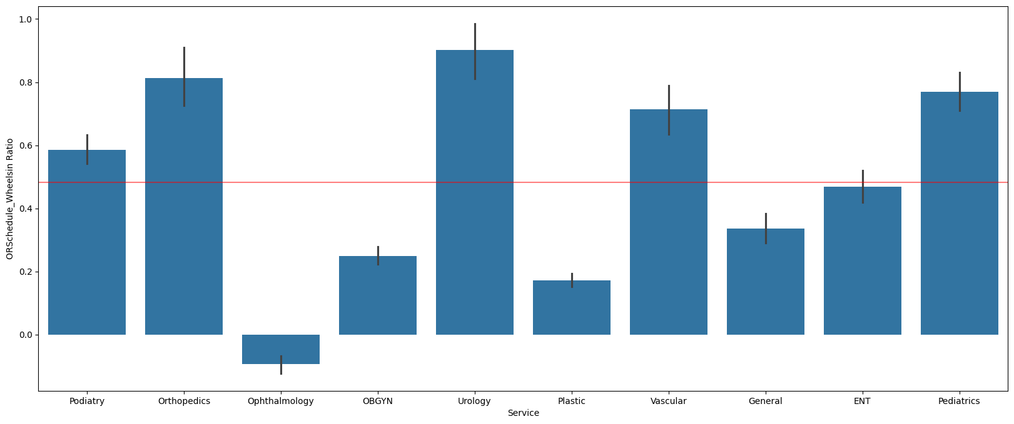
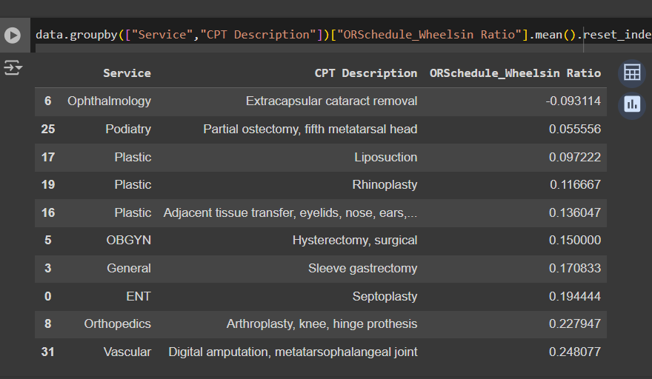
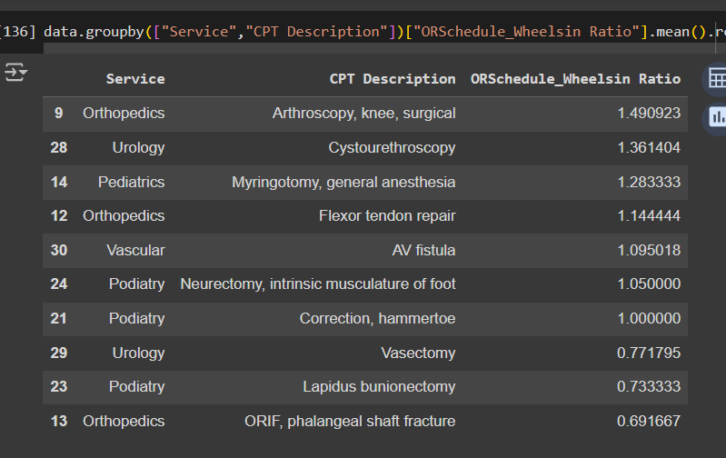
ORSchedule_Wheelsin
Avg Ratio W.r.t Booked time | 0.48
Complete Waste Time due to Inaccurate Planning of Operator
Service Wise:
Top10 CPT Procedure:
Bottom10 CPT Procedure:
Urology[90%],Orthopedic[81%], Pediatrics[77%] are very Irregular in Meeting the Planned Schedule
However, Ophthalmology Starts Procedure Quite Before Planned Schedule

Slide 16
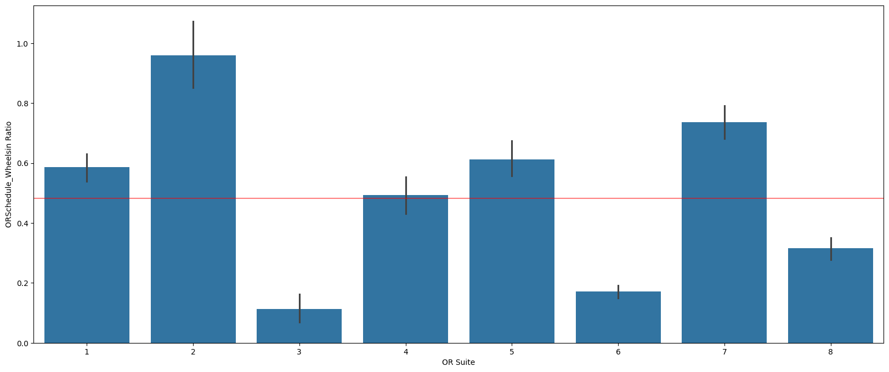
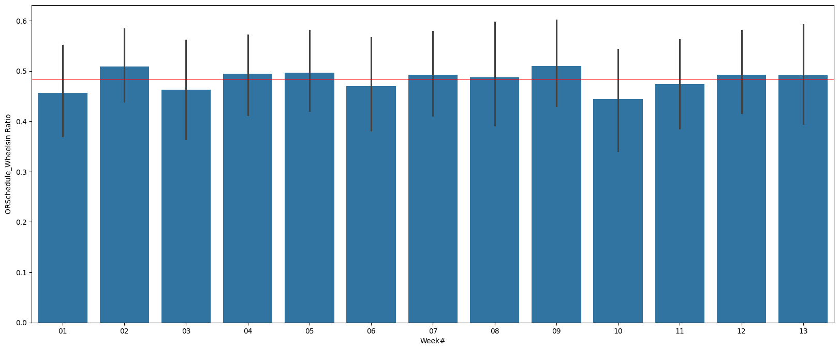
ORSchedule_Wheelsin
Avg Ratio W.r.t Booked time | 0.48
Complete Waste Time due to Inaccurate Booking
OR Suite
Week Wise
Although OR Suites Show Some Trend, they are correlated to Service as OR Suite are Directly Related to Service
Week wise not Much Variation Observed

Slide 17
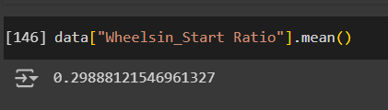
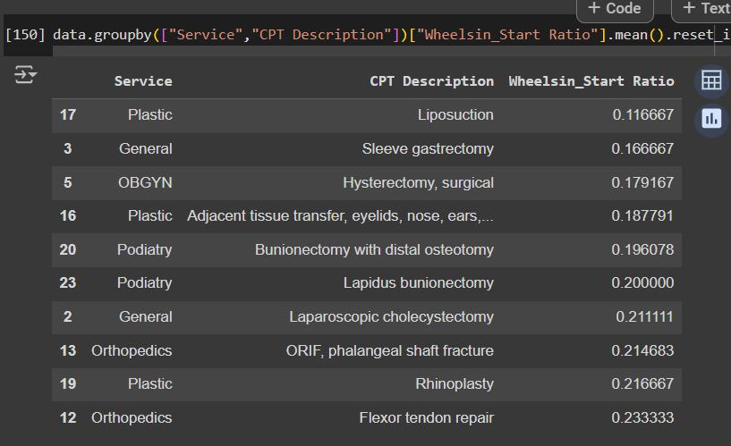
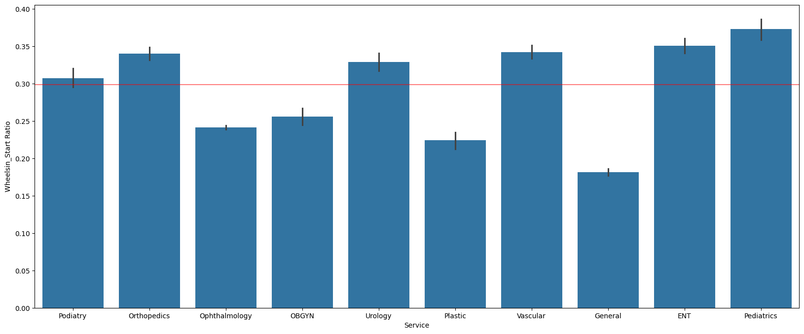
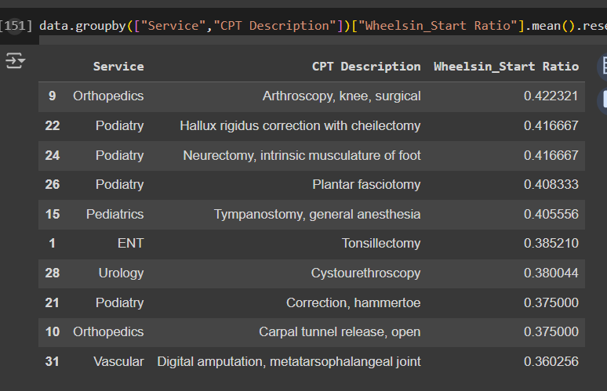
Wheelsin_Start
Avg Ratio W.r.t Booked time | 0.29
Can be Optimised by Proper Planning
Service Wise:
Top10 CPT Procedure:
Bottom10 CPT Procedure:
Pediatrics[37%],ENT[35%],Orthopedics & Vascular[34%] takes Comparatively High Preparation Time before Procedure Starts

Slide 18
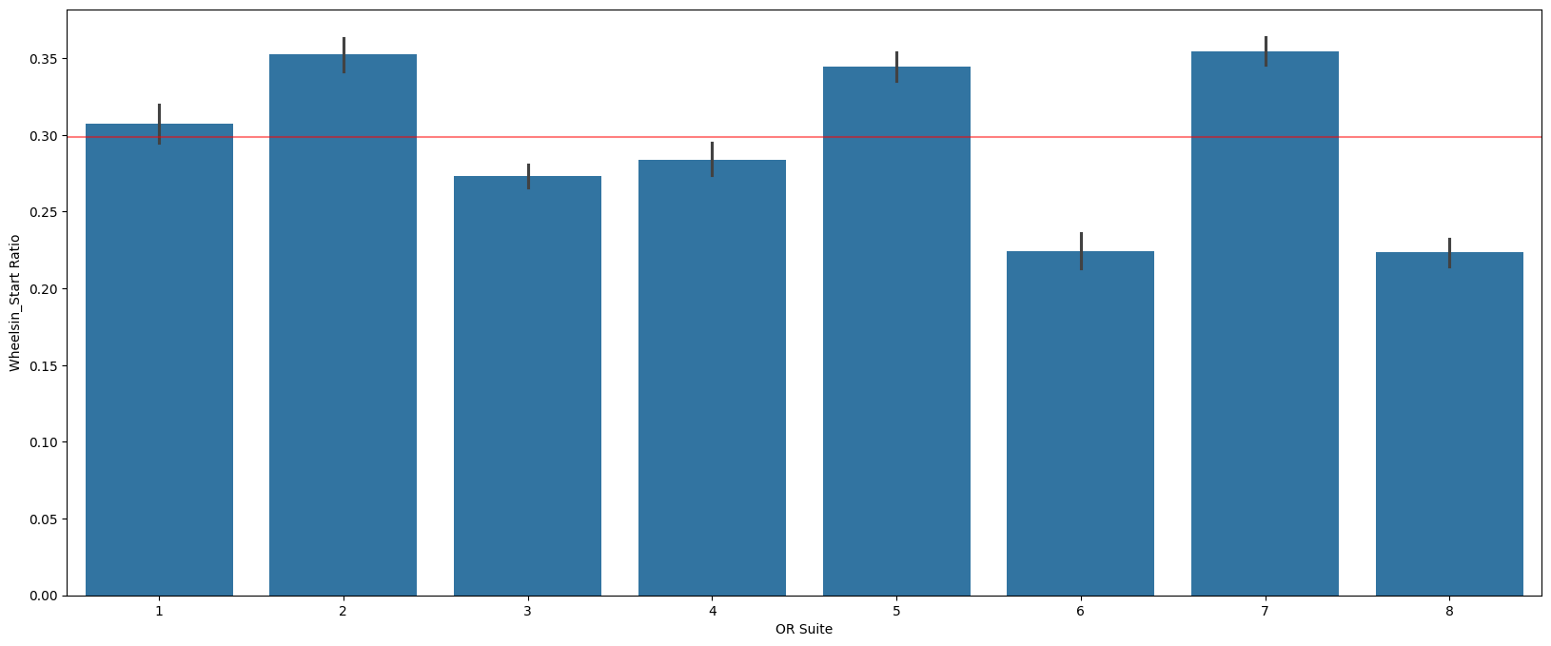
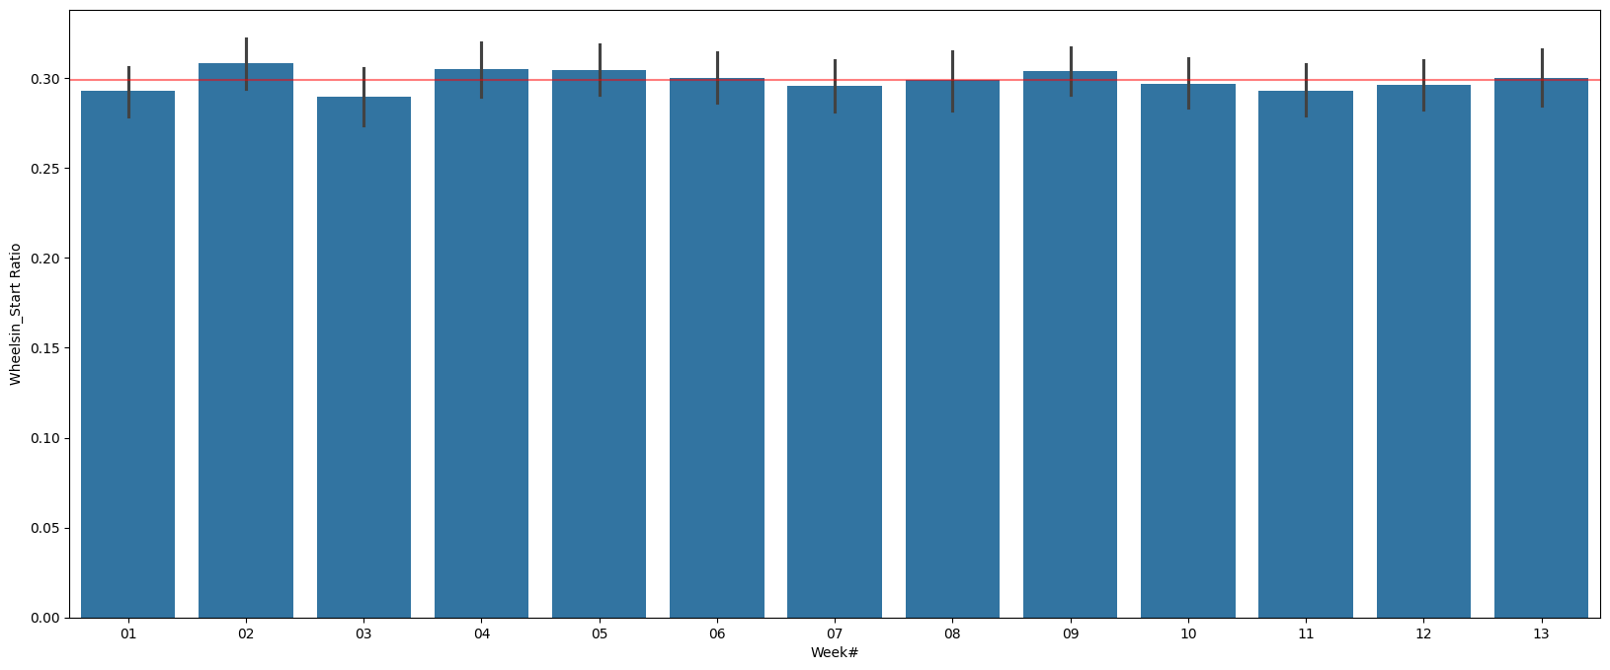
Wheelsin_Start
Avg Ratio W.r.t Booked time | 0.29
Can be Optimised by Proper Planning
OR Suite:
Week Wise:
Although OR Suites Show Some Trend, they are correlated to Service as OR Suite are Directly Related to Service
Week wise not Much Variation Observed

Slide 19
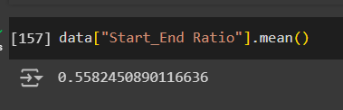
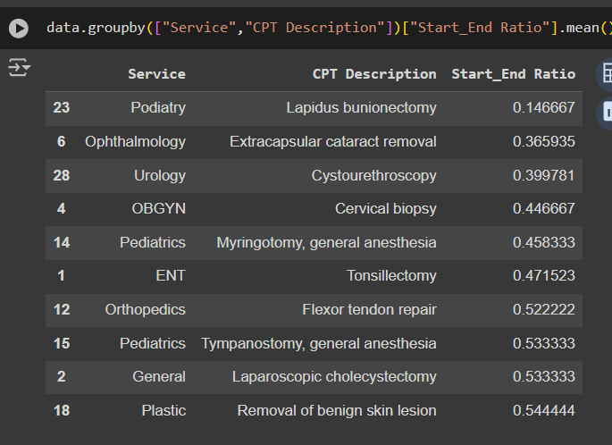
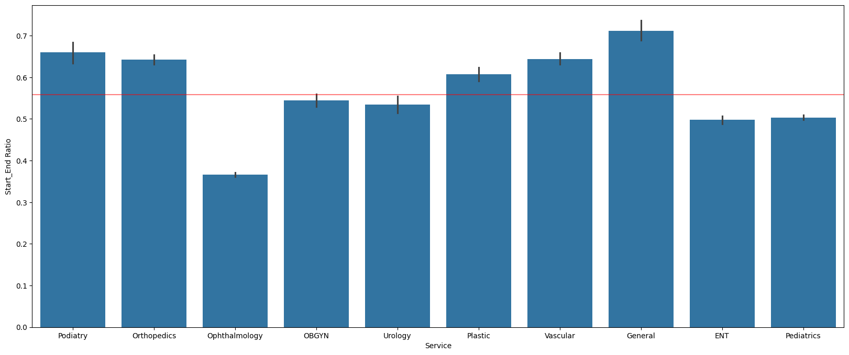
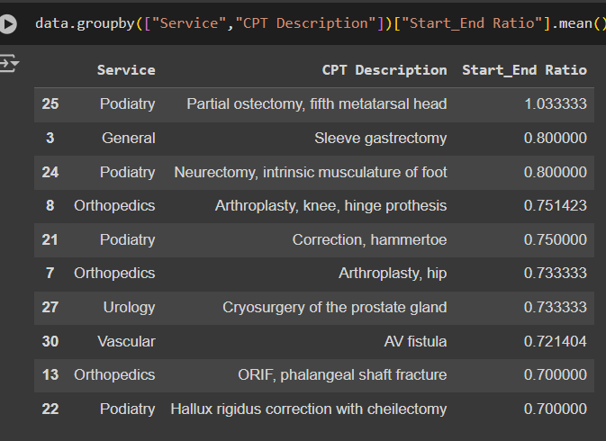
Start_End
Avg Ratio W.r.t Booked time | 0.55
Depends on Procedure being done… Cannot be Judged on basis of this Data
Service Wise:
Top10 CPT Procedure:
Bottom10 CPT Procedure:
Start_End Depends on the CPT Procedure & patient Condition, so We cannot Analyze this Key stage with Present Dats

Slide 20

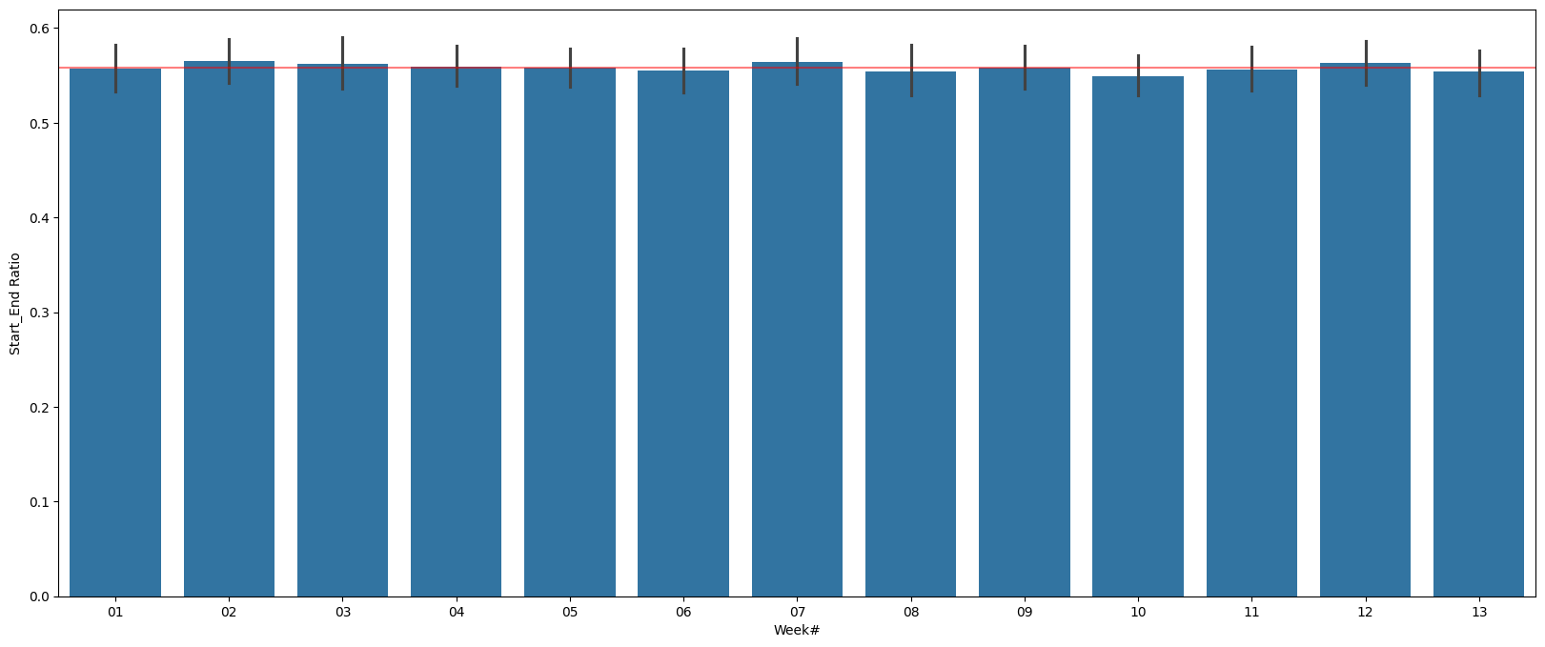
Start_End
Avg Ratio W.r.t Booked time | 0.55
Depends on Procedure being done… Cannot be Judged on basis of this Data
OR Suite:
Week Wise:
Although OR Suites Show Some Trend, they are correlated to Service as OR Suite are Directly Related to Service
Week wise not Much Variation Observed

Slide 21
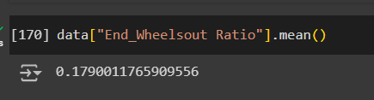
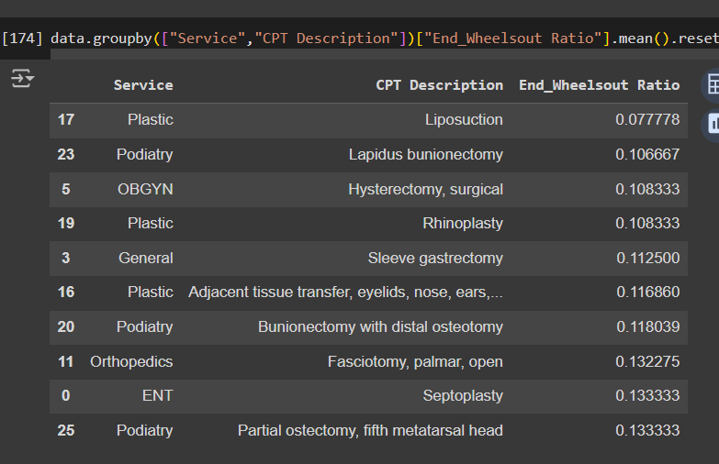
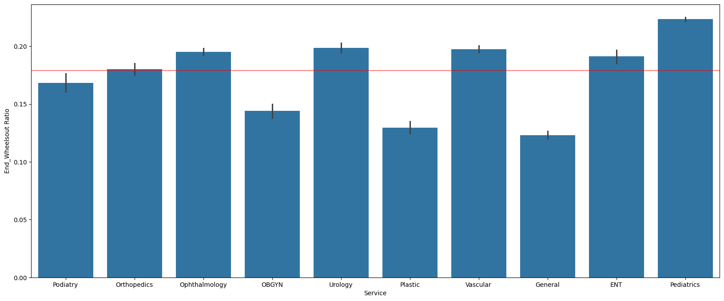
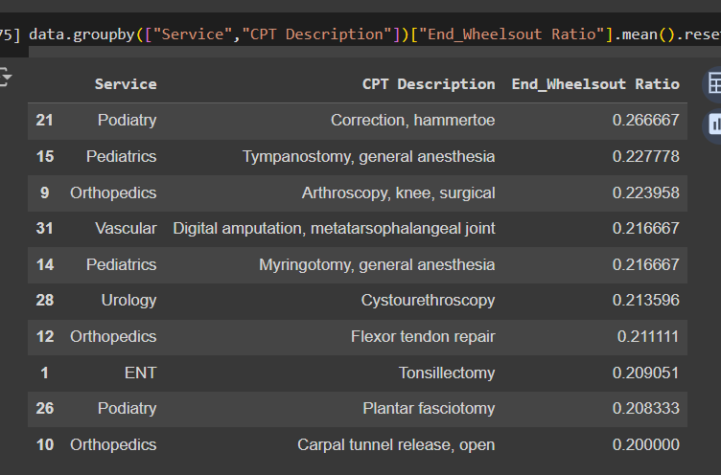
End_Wheelsout
Avg Ratio W.r.t Booked time | 0.179
Can be Optimised by Proper Planning
Service Wise:
Top10 CPT Procedure:
Bottom10 CPT Procedure:
Pediatrics ,ENT, Urology, Vascular ,Ophthalmology has high closing time after Procedure Ends

Slide 22
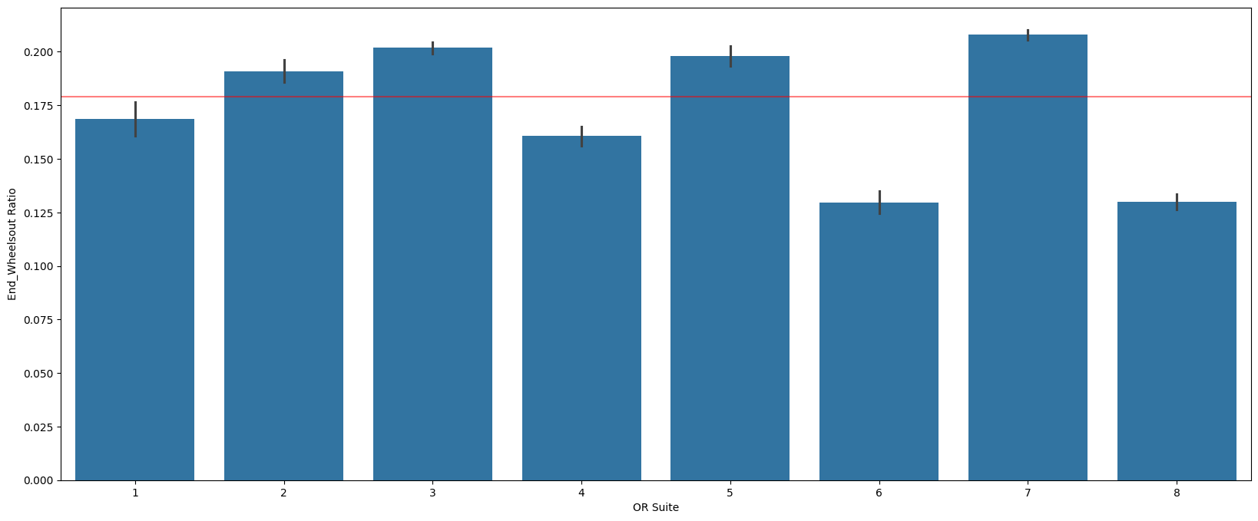
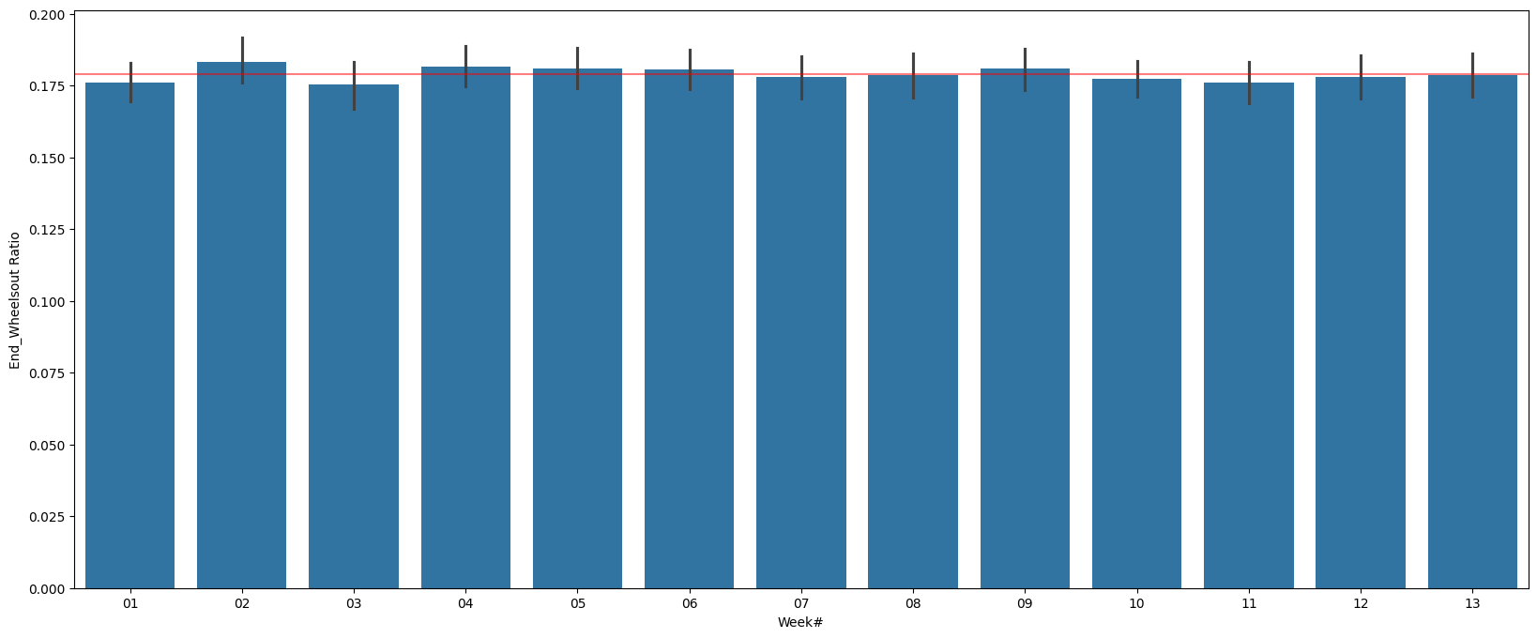
End_Wheelsout
Avg Ratio W.r.t Booked time | 0.179
Can be Optimised by Proper Planning
OR Suite:
Week Wise:
Although OR Suites Show Some Trend, they are correlated to Service as OR Suite are Directly Related to Service
Week wise not Much Variation Observed

Slide 23
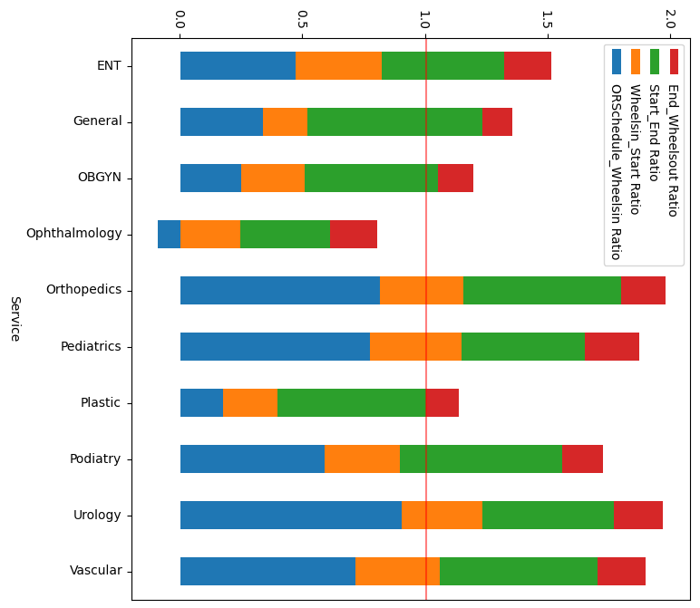
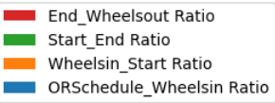
Overall Analysis of key stages Duration Ratio – Service Wise
Overall OR Engagement ratio wr.t Booked time is High with Orthopedics, Pediatrics, Urology, Vascular & Podiatry → Drastic need to Work on Improvement of Planning in these Services
Ophthalmology has Best Overall OR Engagement ratio wr.t Booked time → Booking Time & Planning is good

Slide 24
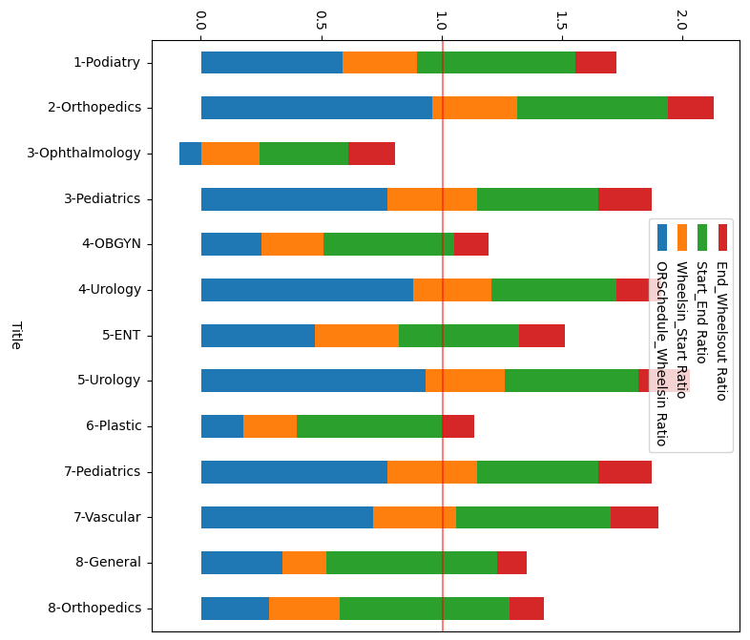
Overall Analysis of key stages Duration Ratio – OR Suite & Service Wise
OR Suite - Service
We can Confirm that OR Suite Has less Dominance on the Overall Ratio, rather Service & CPT Procedure done has impact on the Overall Usage ratios
So, We must Focus on CPT Procedure to Optimize Resources
Orthopedics Procedures in OR Suite 8 have better usage Efficacy Comparatively, may be due to CPT Procedure done in OR Suite-8

Slide 25



Potential cost savings and increase procedure throughput
To calculate Potential Cost Saving, we will consider below Assumptions
Consider ORSchedule_Wheelsin to be “0”
Assume Minimum Time for Each CPT Procedure among Data
Wheelsin_Start
End_Wheelout
We will not assume Start_End as it might Vary for each patient to Patient
By Improving Operational efficiencies, we will be able to Optimize the Resource utilization by 36%

Slide 26
Road Map For Improvement
For the Road map , we will have below Assumptions for Understanding Reference
We will consider the Present Workload and Compare Resource Usage % against All Conditions
We will Consider Revenue Generated /Procedure Throughput as 100% and use it for Representation against All Conditions
Let us Assume the Present 84% as the Maximum tight Schedule Possible for all OR Suite to remove Side by Side Schedule
Free Time for OR Suites to Avoid Side by Side Schedule
Matching OR Schedule & Wheelsin Timing
Improving Operational Efficiencies of
Wheelsin to Start & End to Wheelsout
Increasing Working Hrs from 10 → 12 Hrs
[7:00 ~ 19:00]
Increasing Working Days in week
MTWTF + Sa [5 →6]
Resource Usage %
Work Throughput/ Revenue Generated | 100% | 149% | 156% | 187% | 227%
By Improving Operational efficiencies & Working Hrs, Revenue can be Increase by 127%

Slide 27
Final Analysis Summary
Insights | Recommendations
OR Rooms are used only between 7:00 ~ 17:00 and only on Weekdays i.e., 5 Days Actual Utilization rate w.r.t. to Total Available OR Suite Time is Low i.e, 58% only | By Increasing the Working Hrs [10 – 12 Hrs] & Working Days [5 →6], Procedure Throughput can be Increase by 127%
Actual Usage time is 3% More than the Booked time, But Overall OR Suite Engaged time is 49% more than booked time meaning its is blocked but not used | Timely Reminders with continuous Intimation before 1day, 1hr, 15min to ensure team’s minimized time between ORSchedule_Wheelsin By Improving Operational efficiencies, we will be able to Reduce the OR Suite Engagement time by 36%
Utilization rate Varied w.r.t OR Suites.. Varied around 50.83 [OR:3]~62.37%[OR:1] | Resource Balancing & Utilization can be done with external agencies in the Unused OR Suite Time like in Afternoon
80% of the OR Procedures are done only in the Morning 7:00 ~ 12:00
Booking rate is comparatively high in the Middle of Week and Low on Monday & Friday
Podiatry and Orthopedics Services Booking time must be correctly Recalibrated as per Each CPT Procedure, as present Bookings are Inaccurate [Sometime Overbooking & under booking] irrespective of CPT Procedure | CPT Procedure wise Booking Slots With historical Data like Mean ± 1 Std Dev can be Prefixed in the System to avoid overbooking and underbooking for given procedure
Urology[Delay 90% of Booked Time],Orthopedic[81%], Pediatrics[77%] in Meeting the Planned Schedule | Timely Reminders with continuous Intimation before 1day, 1hr, 15min to ensure team’s minimized time between ORSchedule_Wheelsin
Pediatrics[Delay 37% of Booked Time],ENT[35%],Orthopedics & Vascular[34%] takes Comparatively High Preparation Time before Procedure Starts | Pre & Post Preparation to be done to Reduce Wheels n to Start Time as Almost Different OR Suites are Used by Different Services
Comparatively Pediatrics ,ENT, Urology, Vascular ,Ophthalmology has high closing time after Procedure Ends
Overall OR Engagement ratio wr.t Booked time is High with Orthopedics, Pediatrics, Urology, Vascular & Podiatry → Drastic need to Work on Improvement of Planning in these Services | Ophthalmology has Best Overall OR Engagement ratio wr.t Booked time → Booking Time & Planning is good → Panning Methodology used by Opthalmology can be Horizontaly Knowledge Transferred to Other Specialities

